Slide 1

I CAN HAS F#$@ IN MONODEVELOP?
Tomáš Petříček, http://tomasp.net

Slide 2
What is F#?
Functional Language for CLI
Interactive Scripting
Functional Core
CLI Object Model

Slide 3

F# and Open Source

Slide 4
F# and Open Source
Shipped with source code (since early version)
Somewhat limiting non-standard license
F# binding for MonoDevelop (October 2010)
Open Source community project
Open source code drop (November 2010)
Apache 2 license, Builds on Win/Linux/Mac
No community contributions
Included in Mono 2.10 RC2 (January 2011)

Slide 5
EXAMPLE Introducing Functional Style
Composing mathematical expressions and 3D objects

Slide 6
Functional Programming
Functional programming is like math…
Refactoring in math always works!

Slide 7

Functional Programming

Slide 8
EXAMPLE F# for Scripting and Exploring
Using Gtk# libraries interactively Finding the most verbose .NET type

Slide 9
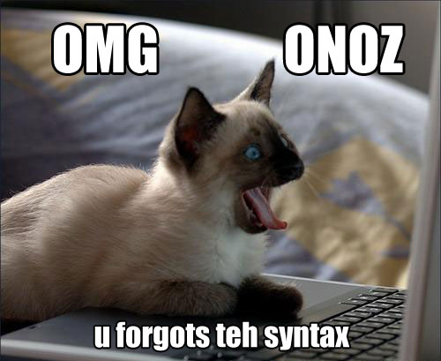
Exploring .NET libraries with F#

Slide 10
EXAMPLE Server-side programming in F#
Asynchronous chat server written in “Node.js” style

Slide 11

Server-side programming in F#

Slide 12

Contribute to the F# plugin!

Slide 13
Contribute to the F# plugin!
Editor features
Go to definition and navigation bar
Improve colorization and collapse type definitions
Other work items
Reordering project files in MonoDevelop
Support Gtk# designer
Debugging of F# code in MonoDevelop
F# resolver provider
For more items, visit the wiki
http://github.com/fsharp/fsharpbinding
Would love to see it in standard distribution!

Slide 14

Academic & cross platform homepage and source code http://functional-variations.net | http://github.com/fsharp
Contact and links (Contributors welcome!) tomas@tomasp.net | http://tomasp.net http://twitter.com/tomaspetricek

